Slide 1
Electronic Devices
Mid Term Lecture - 01
Faculty Name: Dr. Mohammad Alif Arman
Email : dr.alifarman@aiub.edu
Reference book:
Electronic Devices and Circuit Theory (Chapter-1)
Robert L. Boylestad and L. Nashelsky , (11th Edition)

Slide 2
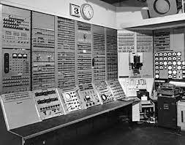

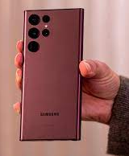
Introduction
The technology advancing so fast and so the fundamental principles. Systems are incredibly smaller, current speeds of operation are truly remarkable, and new gadgets surface every day, leaving us to wonder where technology is taking us.

Slide 3
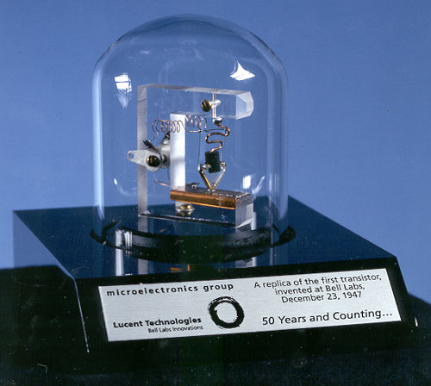
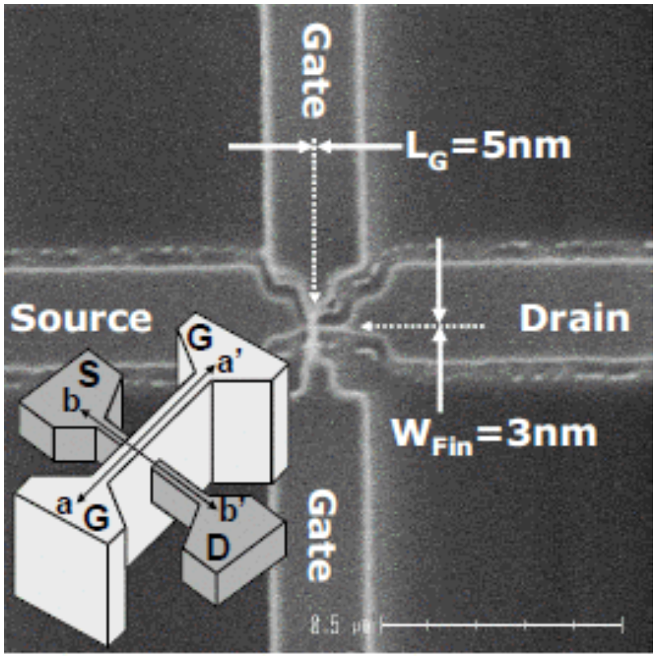
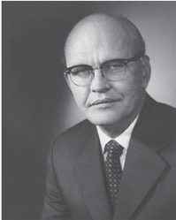
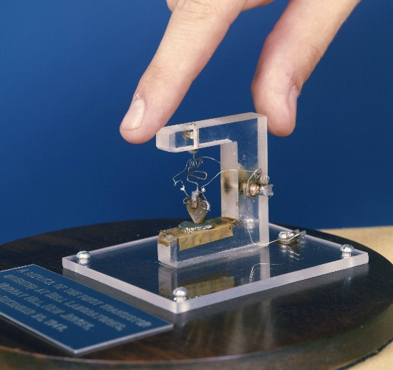
Introduction Contd.
Figure 1.1: Jack St. Clair Kilby, inventor (1958) of the integrated circuit and co-inventor of the electronic handheld calculator. (Texas Instruments.)
Complete systems now appear on wafers thousands of times smaller than the single element of earlier networks.

Slide 4
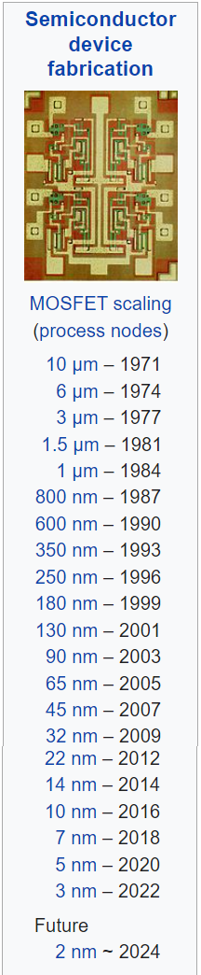
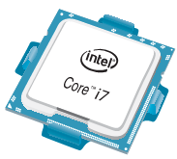
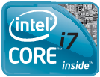
Introduction Contd.
Today, the Intel® CoreTM i7 Extreme Edition Processor of Fig. 1.2 has 731 million transistors in a package that is only slightly larger than a 1.67 sq. inches.
In 1965, Dr. Gordon E. Moore presented a paper predicting that the transistor count in a single IC chip would double every two years.
Now, more than 45 years, later we find that his prediction is amazingly accurate and expected to continue for the next few decades.
Figure 1.2: Intel® Core™ i7 Extreme Edition Processor.

Slide 5
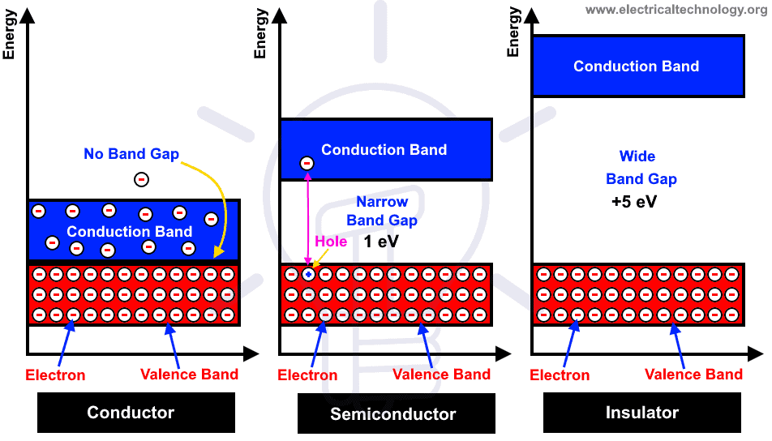
Materials

Slide 6
Why do we use semiconductors instead of conductors in electronics fabrication?
To control.
Transistors need to be able to give us two different outputs to perform logic functions; that is "1" (on) and "0" (off). In short switching ability.

Slide 7
Why do we use semiconductors instead of conductors in electronics fabrication?
Semiconductor materials have a negative temperature coefficient.
Semiconductor materials, however, exhibit an increased level of conductivity with the application of heat. As the temperature rises, an increasing number of valence electrons absorb sufficient thermal energy to break the covalent bond and to contribute to the number of free carriers.
For conductors, the resistance increases with an increase in heat. This is because the numbers of carriers in a conductor do not increase significantly with temperature, but their vibration pattern about a relatively fixed location makes it increasingly difficult for a sustained flow of carriers through the material.
Materials that react in this manner are said to have a positive temperature coefficient.

Slide 8
Semiconductor Materials: Ge, SI & GaAs
The construction of every discrete (individual) solid-state (hard crystal structure) electronic device or integrated circuit begins with a semiconductor material (of the highest quality).
Semiconductors are elements having a conductivity between that of a good conductor and that of an insulator.
In general, semiconductor materials fall into one of two classes: single-crystal and compound.
Single-crystal semiconductors such as germanium (Ge) and silicon (Si) have a repetitive crystal structure, whereas compound semiconductors such as gallium arsenide (GaAs), cadmium sulfide (CdS), gallium nitride (GaN), and gallium arsenide phosphide (GaAsP) are constructed of two or more semiconductor materials of different atomic structures.
Ge, Si, and GaAs semiconductors used most frequently in the construction of electronic devices.
What is single-crystal and compound?

Slide 9
Semiconductor Materials: Ge, SI & GaAs Contd.
Germanium:
In the first few decades following the discovery of the diode in 1939 and the transistor in 1947 germanium was used almost exclusively because it was relatively easy to find and was available in fairly large quantities.
It was also relatively easy to refine to obtain very high levels of purity, an important aspect in the fabrication process.
However, it was discovered in the early years that diodes and transistors constructed using germanium as the base material suffered from low levels of reliability due primarily to its sensitivity to changes in temperature.

Slide 10
Semiconductor Materials: Ge, SI & GaAs Contd.
Silicon:
At the time, scientists were aware that another material, silicon, had improved temperature sensitivities, but the refining process for manufacturing silicon of very high levels of purity was still in the development stages. In 1954 the first silicon transistor was introduced, and silicon quickly became the semiconductor material of choice due to,
Silicon is Less temperature sensitive
one of the most abundant materials on earth, removing any concerns about availability.

Slide 11
Semiconductor Materials: Ge, SI & GaAs Contd.
Gallium Arsenide:
As time moved on, however, the field of electronics became increasingly sensitive to issues of speed.
Scientist developed the first compound material GaAs transistor in the early 1970s.
The speed of operation: up to FIVE times that of Si.
GaAs was more difficult to manufacture at high levels of purity, was more expensive, and had little design support in the early years of development.
However, in time the demand for increased speed resulted in more funding for GaAs research, to the point that today it is often used as the base material for new high-speed, very large scale integrated (VLSI) circuit designs.

Slide 12
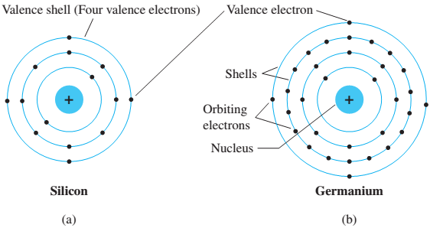
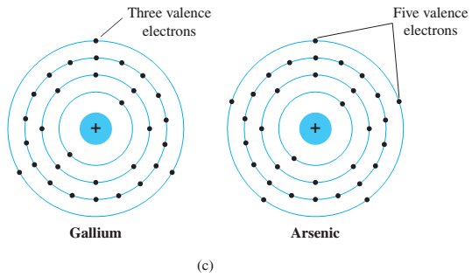

Covalent Bonding and Intrinsic Materials
To fully appreciate why Si, Ge, and GaAs are the semiconductors of choice for the electronics industry requires some understanding of the atomic structure of each and how the atoms are bound together to form a crystalline structure.
The fundamental components of an atom are the electron, proton, and neutron.
In the lattice structure, neutrons and protons form the nucleus and electrons appear in fixed orbits around the nucleus. The Bohr model for the three materials is provided in Fig. 1.3.

Slide 13
Covalent Bonding & Intrinsic Materials Contd.
As indicated in Fig. 1.3, silicon has 14 orbiting electrons, germanium has 32 electrons, gallium has 31 electrons, and arsenic has 33 orbiting electrons (the same arsenic that is a very poisonous chemical agent).
For germanium and silicon there are four electrons in the outermost shell, which are referred to as valence electrons.
Gallium has three valence electrons and arsenic has five valence electrons.
Atoms that have four valence electrons are called tetravalent, those with three are called trivalent, and those with five are called pentavalent.
The term valence is used to indicate that the potential (ionization potential) required to remove any one of these electrons from the atomic structure is significantly lower than that required for any other electron in the structure.

Slide 14
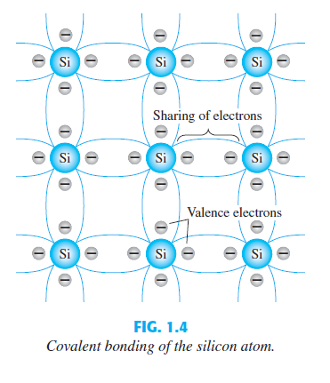
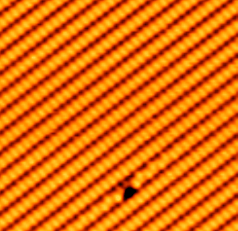
Covalent Bonding & Intrinsic Materials Contd.
In a pure silicon or germanium crystal the four valence electrons of one atom form a bonding arrangement with four adjoining atoms, as shown in Fig. 1.4.
This bonding by the sharing of electrons, is called covalent bonding.

Slide 15
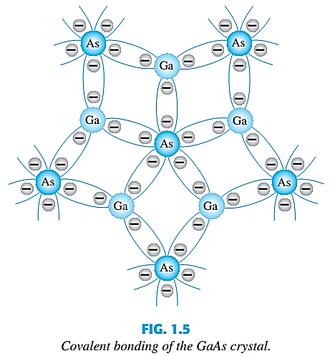
Covalent Bonding & Intrinsic Materials Contd.
Because GaAs is a compound semiconductor, there is sharing between the two different atoms, as shown in Fig. 1.5.
Each atom, gallium or arsenic, is surrounded by atoms of the complementary type. Here five electrons are provided by the As atom and three by the Ga atom.

Slide 16
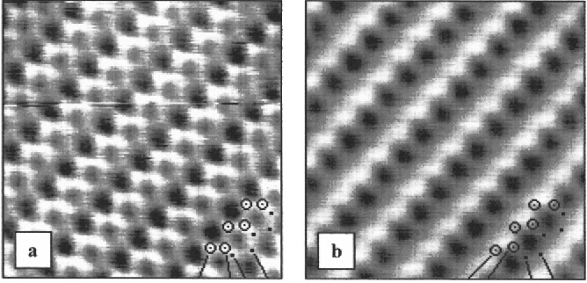
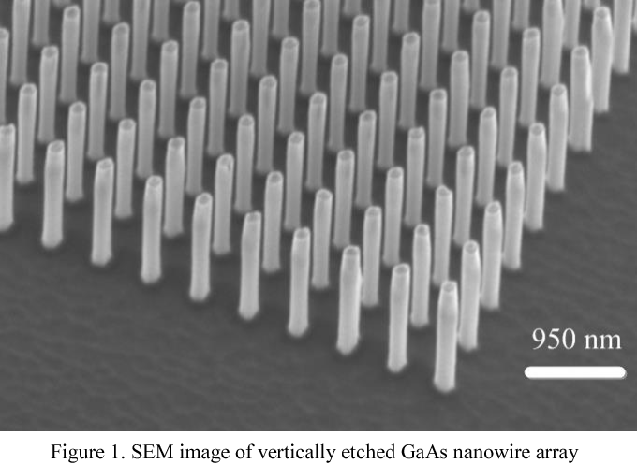
Semiconductor Materials: Ge, SI & GaAs Contd.
Gallium Arsenide:
c

Slide 17
Covalent Bonding & Intrinsic Materials Contd.
Although the covalent bond will result in a stronger bond between the valence electrons and their parent atom, it is still possible for the valence electrons to absorb sufficient kinetic energy from external natural causes to break the covalent bond and assume the “free” state.
The term free is applied to any electron that has separated from the fixed lattice structure and is very sensitive to any applied electric fields such as established by voltage sources or any difference in potential.
The external causes include effects such as light energy in the form of photons and thermal energy (heat) from the surrounding medium.
At room temperature there are approximately 1.5 * 10¹⁰ free carriers in 1 cm³ of intrinsic silicon material, that is, 15,000,000,000 (15 billion) electrons in a space smaller than a small sugar cube - an enormous number.
What is FREE Electron?

Slide 18
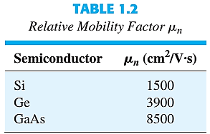
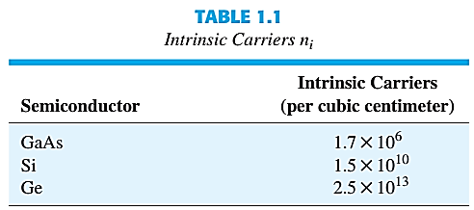
Covalent Bonding & Intrinsic Materials Contd.
The term intrinsic is applied to any semiconductor material that has been carefully refined to reduce the number of impurities to a very low level-essentially as pure as can be made available through modern technology.
The free electrons in a material due only to external causes are referred to as intrinsic carriers. Table1.1 compares the number of intrinsic carriers per cubic centimeter(abbreviated n_{i}) for Ge, Si, and GaAs.

Slide 19
Covalent Bonding & Intrinsic Materials Contd.
It is interesting to note that Ge has the highest number of free electron and GaAs the lowest.
In fact, Ge has more than twice the number as GaAs.
The number of carriers in the intrinsic form is important, but other characteristics of the material are more significant in determining its use in the field.
One such factor is the relative mobility (µ_{n}) of the free carriers in the material, that is, the ability of the free carriers to move throughout the material.
Table 1.2 clearly reveals that the free carriers in GaAs have more than five times the mobility of free carriers in Si, a factor that results in response times using GaAs electronic devices that can be up to five times those of the same devices made from Si.
Note also that free carriers in Ge have more than twice the mobility of electrons in Si, a factor that results in the continued use of Ge in high-speed radio frequency applications.

Slide 20
Covalent Bonding & Intrinsic Materials Contd.
Extremely high levels of purity are necessary because the addition of one part of impurity (of the proper type) per million in a wafer of silicon material can change that material from a relatively poor conductor to a good conductor of electricity.
The ability to change the characteristics of a material through this process is called doping, something that germanium, silicon, and gallium arsenide readily and easily accept.
One important and interesting difference between semiconductors and conductors is their reaction to the application of heat.

Slide 21
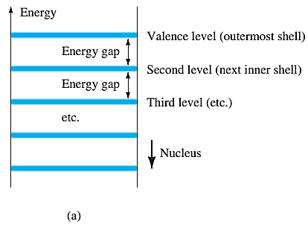
Energy Levels
Within the atomic structure of each and every isolated atom there are specific energy levels associated with each shell and orbiting electron, as shown in Fig. 1.6.
The energy levels associated with each shell will be different for every element.
The farther an electron is from the nucleus, the higher is the energy state, and any electron that has left its parent atom has a higher energy state than any electron in the atomic structure.

Slide 22
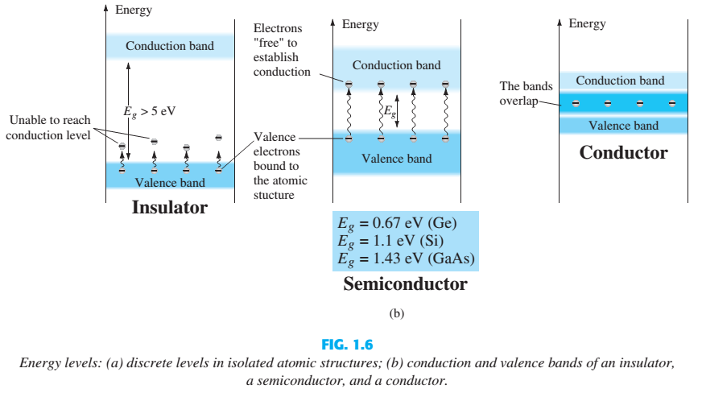
Energy Levels Contd.

Slide 23
n-Type & p-Type Materials
The characteristics of a semiconductor material can be altered significantly by the addition of specific impurity atoms to the relatively pure semiconductor material.
These impurities, although only added at 1 part in 10 million, can alter the band structure sufficiently to totally change the electrical properties of the material.
A semiconductor material that has been subjected to the doping process is called an extrinsic material.
There are two extrinsic materials of massive importance to semiconductor device fabrication: n -type and p -type materials.

Slide 24
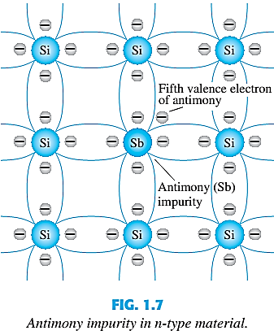
n-Type Material
An n -type material is created by introducing impurity elements that have five valence electrons (pentavalent), such as antimony, arsenic, and phosphorus. (Group V elements in Periodic Table)
The effect of such impurity elements is indicated in Fig. 1.7 (using antimony as the impurity in a silicon base).

Slide 25
n-Type Material Contd.
Note that the four covalent bonds are still present. There is, however, an additional fifth electron due to the impurity atom, which is unassociated with any particular covalent bond.
This remaining electron, loosely bound to its parent (antimony) atom, is relatively free to move within the newly formed n -type material.
Diffused impurities with five valence electrons are called donor atoms.
It is important to realize that even though a large number of free carriers have been established in the n -type material, it is still electrically Positive or negative?
neutral since ideally the number of positively charged protons in the nuclei is still equal to the number of free and orbiting negatively charged electrons in the structure.

Slide 26
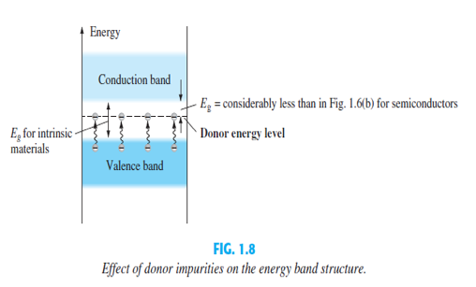
n-Type Material Contd.
Those free electrons due to the added impurity sit at this energy level and have less difficulty absorbing a sufficient measure of thermal energy to move into the conduction band at room temperature.
Conductivity of the material will increase or decrease?
The result is that at room temperature, there are a large number of carriers (electrons) in the conduction level, and the conductivity of the material increases significantly.
In which application this process is crucial?
Photo electric effect – Solar cell

Slide 27
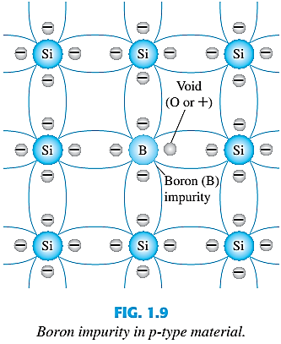
p-Type Material
The p -type material is formed by doping a pure germanium or silicon crystal with impurity atoms having three valence electrons.
The elements most frequently used for this purpose are boron, gallium, and indium. (Group III elements in Periodic Table)
Note that there is now an insufficient number of electrons to complete the covalent bonds of the newly formed lattice.

Slide 28
p-Type Material Contd.
The resulting vacancy is called a hole and is represented by a small circle or a plus sign, indicating the absence of a negative charge.
Since the resulting vacancy will readily accept a free electron:
The added impurities with three valence electrons are called acceptor atoms.
The resulting p -type material is electrically - +?
neutral, for the same reasons described for the n -type material.

Slide 29
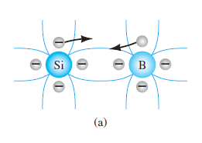
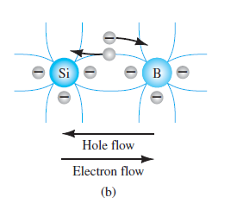
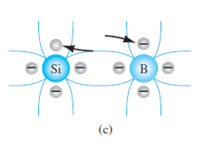
Electron vs Hole Flow
The effect of the hole on conduction is shown in Fig. If a valence electron acquires sufficient kinetic energy to break its covalent bond and fills the void created by a hole, then a vacancy, or hole, will be created in the covalent bond that released the electron.

Slide 30
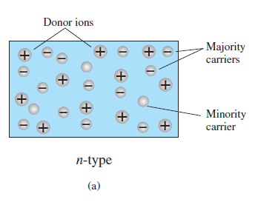
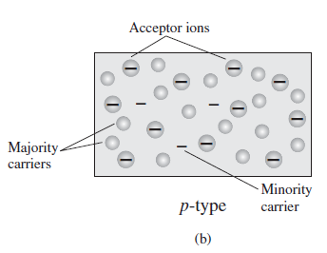
Majority & Minority Carriers
In an n-type material ( Fig. a ) the electron is called the majority carrier and the hole the minority carrier.
In a p-type material the hole is the majority carrier and the electron is the minority carrier.

Slide 31
Outcome
Knowledge
Basic of semiconductor
Doping principles
Crystal Structure
Importance and principles of Semiconductor
Control electronics
Semiconductor materials have a negative temperature coefficient.
Practical applications
Logic Circuit
CPU
Diode
Solar cell

Slide 32
Did this lecture achieve its objectives?

